Slide 1
Colorectal Cancer Survival Prediction using a Cluster then Predict Model

Slide 2
Research Question
Does applying classification to clusters found by unsupervised clustering improve model performance for predicting survivability in Colorectal Cancer?

Slide 3
Colorectal Cancer - 1 of top 5 most prevalent cancers in US - 5-Year relative survival rate is 64.6% - Highly treatable when localized*, 5-Year relative survival rate for localized is 90.2% - Median Age At Death is 72 - Median Age At Diagnosis is 67 - Forms of treatment are typical, including surgery, radiation therapy, immunotherapy, and chemotherapy, but surgery is very common and 50% cured with surgery (especially if early stage)
*Localized cancer is found only in the tissue / organ where it began, has not spread to nearby lymph nodes, can be completely removed by surgery

Slide 4
SEER Database - Surveillance, Epidemiology, and End Results Program is run by National Cancer Institute (NCI) - Database submission used covers 27.8% of the U.S. and cases from 2000-2017 - Total cases: 8,123,183 tumors - Cases of malignant Colon and Rectal cancer: 690,450 - Issues: missing information due to lack of follow up, inconsistent records provided by local health authorities (especially older records), changes in coding systems

Slide 5
Flow Chart Process
Extraction cases from SEER
Data preprocessing (variable selection, record exclusion, cleaning)
Unsupervised clustering and splitting data
Model evaluation and tweaking
Model application
Data normalization

Slide 6
Preprocessing
Start: 690,450 rows and 196 columns
Remove columns with >60% “Blank(s)”
Remove rows with unknown values such as “TX: Main tumor cannot be measured.”
Remove redundant or useless columns based on column description provided by SEER and past literature
Cleaning variables, binning, encode nominal and ordinal variables
Clean target variable (remove cases “death caused by other reason”)
Make 3 separate target variable columns, 1 continuous (in months), 2 categorical (3 ranges: 0-29, 30-59, 60+ and 6 ranges: 0-11, 12-23, 24-35, 36-47, 48-59, 60+)
End: 178,455 rows, 25 columns and 3 target variable columns

Slide 7
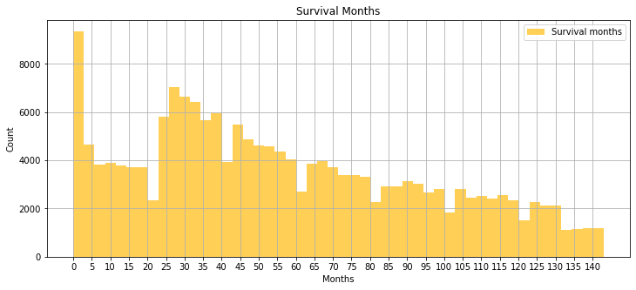
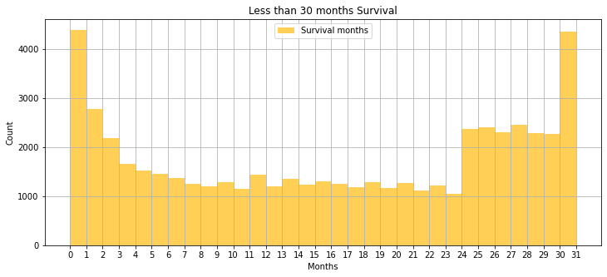
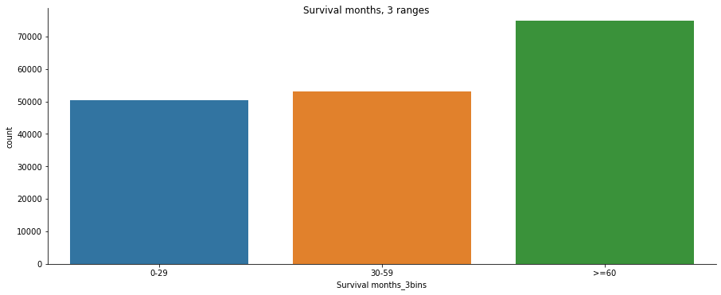
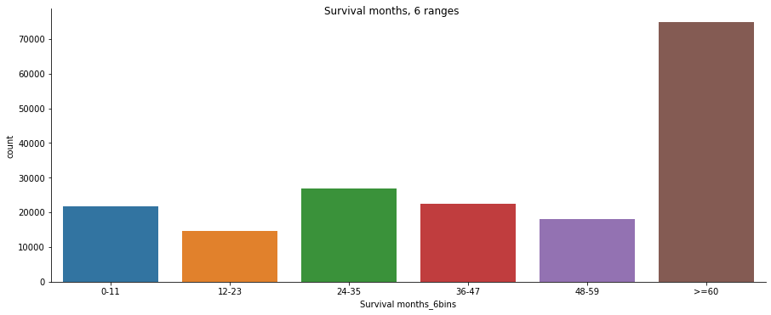
Preprocessing – Visualization of Variables
74917
53096
50442
Notes:
Survival months: Right skew, median (50.0) slightly lower than mean (56.57), two peaks, 0 and 30 months
>=60 74917
30-59 53096
0-29 50442

Slide 8
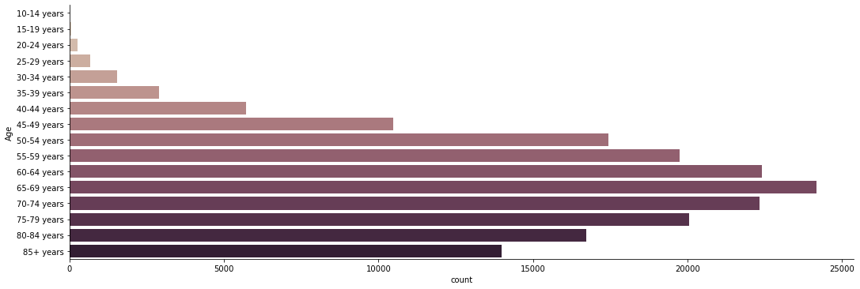
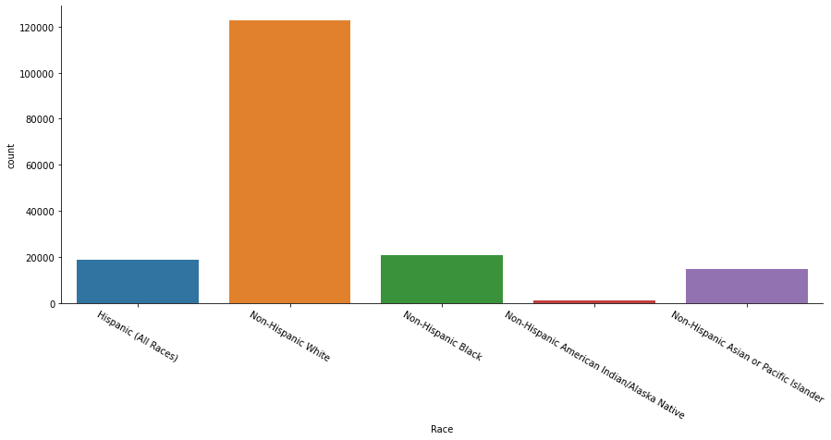
Preprocessing – Visualization of Variables
Age
Race

Slide 9
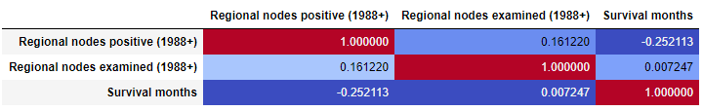
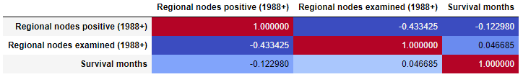
Preprocessing – Visualization of Variables
Regional nodes examined 00: No nodes were examined
Regional nodes positive 00: All nodes examined are negative
98: No nodes were examined
AFTER: Correlation between regional nodes examined and Survival months without 98 values
BEFORE: Correlation between regional nodes examined and Survival months with 98 values

Slide 10
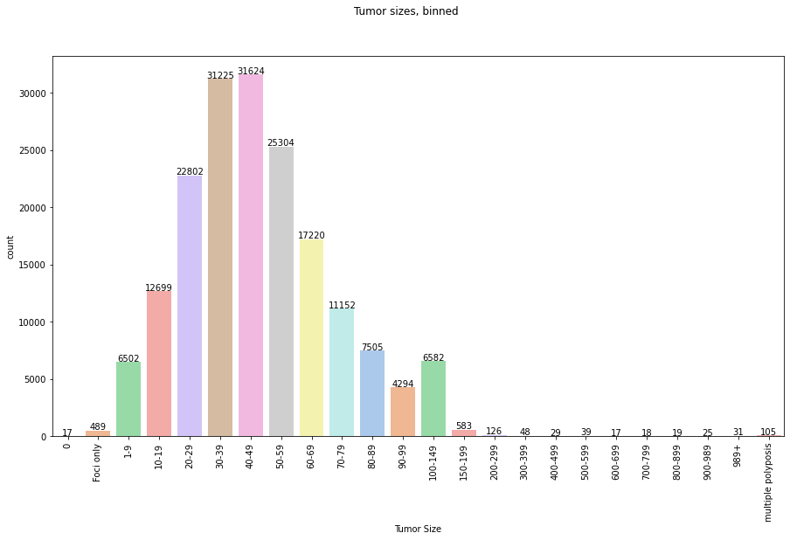
Preprocessing – Visualization of Variables
Tumor size
000: No mass/tumor found
001-988: 001 - 988 millimeters (Exact size in mm)
989: 989 mm or larger
990: Microscopic focus or foci only, no size of focus given
991: Described as "less than 1 cm"
992: Described as "less than 2 cm," or "greater than 1 cm," or "between 1 cm and 2 cm"
993: Described as "less than 3 cm," or "greater than 2 cm," or "between 2 cm and 3 cm"
994: Described as "less than 4 cm," or "greater than 3 cm," or "between 3 cm and 4 cm"
995: Described as "less than 5 cm," or "greater than 4 cm," or "between 4 cm and 5 cm"
998: Familial/multiple polyposis (M-8220/8221)

Slide 11
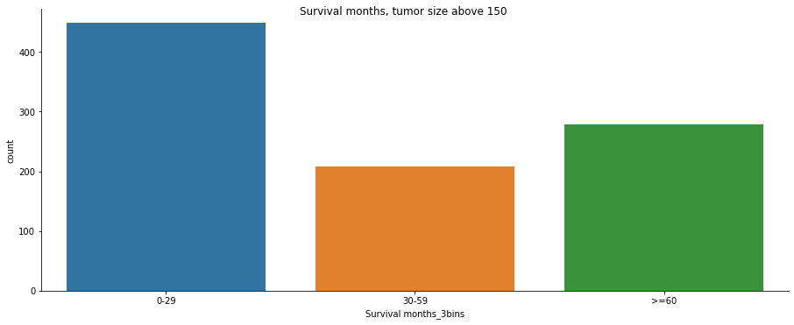
Preprocessing – Visualization of Variables
Tumor size
Bar chart of survival months
Bar chart of survival months for tumors above 150mm

Slide 12
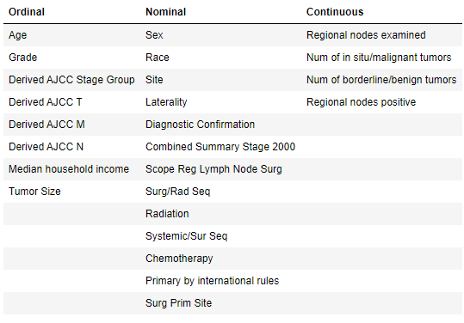
Data Description
Ordinal and Nominal Variables were encoded with integers 1-k
Derived AJCC T Variable Encoded | Int Value
T0: no evidence of a primary tumor (it cannot be found) | 0
Tis: cancer cells are only growing in the layer of cells where they started | 1
T1: the tumor has grown into the submucosa | 2
T2: the tumor has grown into the muscularis propria | 3
T3: the tumor has grown through the muscularis propria and into the subserosa | 4
T4: the tumor has grown through all layers colon / The tumor has grown into or has attached to other organs or structures | 5
Grade Variable Encoded | Int Value
Grade I: Well differentiated | 0
Grade II: Moderately differentiated | 1
Grade III: Poorly differentiated | 2
Grade IV: Undifferentiated; anaplastic | 3
Site Variable Encoded | Int Value
Appendix | 0
Ascending Colon | 1
Cecum | 2
Descending Colon | 3
Hepatic Flexure | 4
Large Intestine, NOS | 5
Rectosigmoid Junction | 6
Rectum | 7
Sigmoid Colon | 8
Splenic Flexure | 9
Transverse Colon | 10

Slide 13
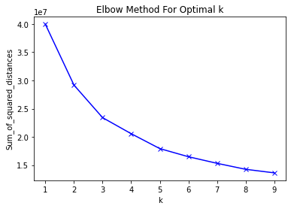
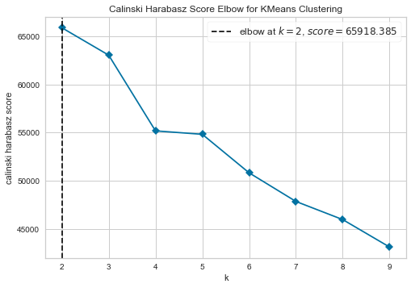
Unsupervised Clustering: Elbow Method → 2 Clusters
Notes:
Run K means on the dataset without any target labels

Slide 14
Unsupervised Clustering: Train/Test Split, K-means Cluster and Scaling Data
datasets = {
'base': (X_train_base, yc_train_base, X_test_base, yc_test_base),
'base': (X_train_base, y6_train_base, X_test_base, y6_test_base),
'base': (X_train_base, y3_train_base, X_test_base, y3_test_base),
'cluster-0': (X_train0, yc_train0, X_test0, yc_test0),
'cluster-0': (X_train0, y6_train0, X_test0, y6_test0),
'cluster-0': (X_train0, y3_train0, X_test0, y3_test0),
'cluster-1': (X_train1, yc_train1, X_test1, yc_test1),
'cluster-1': (X_train1, y6_train1, X_test1, y6_test1),
'cluster-1': (X_train1, y3_train1, X_test1, y3_test1),
}
Train
Base: 124918
Cluster 0: 27596
Cluster 1: 97322
Test
Base: 53537
Cluster 0: 11697
Cluster 1: 41840
Notes:
Train / test split (70% and 30%)
Clustering method only run on data without target labels which is y, (run on X)
Train base, train 0 cluster, train 1 cluster, test base, test 0 and test 1 same. Y (target) is different
First I only ran with 6 ranges, recommended tried regression (specific survival value might be useful), then used 3 ranges as that was more in line with other papers and provided more accuracy
Did k on Train, fit test on K model

Slide 15
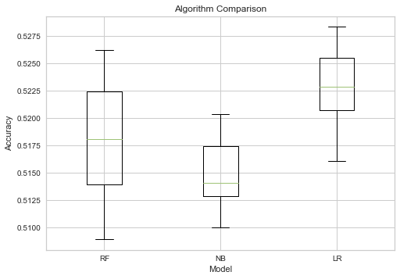
Model Comparison on Base

Slide 16
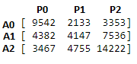
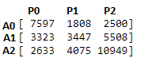
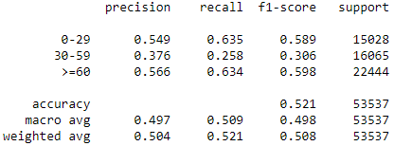
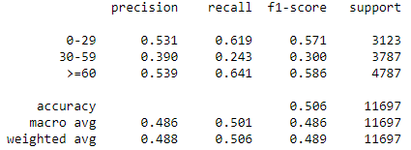
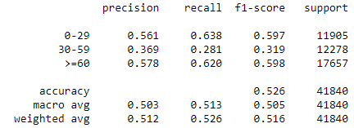
Logistic Regression on base, cluster 0 and cluster 1
Why F1-score used:
F1-score minimizes impact of outliers because it takes reciprocal of it, mitigates the impact of large outliers
Cannot have a high F1-score if either recall or precision is very low
F1-score puts more weight on False Negatives and False Positives
Base Accuracy: 0.521
Cluster 0 Accuracy: 0.506
Cluster 1 Accuracy: 0.526
Notes:
Recall for class 1 very low, false negatives so high (actually 1, mainly predicted to be 0 or 2)
Harmonic mean lower than arithmetic mean, accuracy can be misleading
Precision: TP/TP + FP
Recall: TP / TP+FN
Fscore: 2 TP/ (2TP + FP +FN)
ACC: TP + TN / (TP+TN+FP+TN)
F1-score is used when the False Negatives and False Positives are crucial. ... In most real-life classification problems, imbalanced class distribution exists and thus F1-score is a better metric to evaluate on
The arithmetic mean is 2+4+6+1004 = 28
The harmonic mean is 4/( 12 + 14 + 16 + 1100 ) = 4.32 (to 2 places)

Slide 17
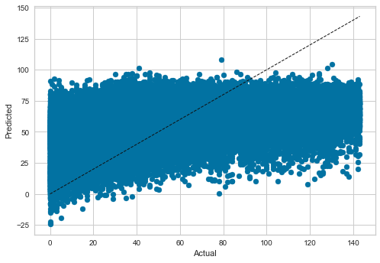
Linear Regression on Base
RMSE: 33.776982044560825
Calculated prediction interval:
+/- (2 * RMSE): +/- 67.55
R² = 0.20495609122261427
Notes:
As survival range increases, predicted diverges from actual

Slide 18
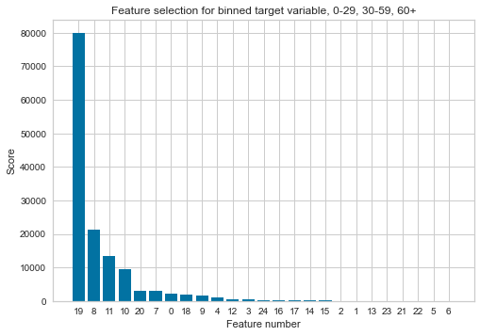
Tweaking model: Filtered Dataset
Top 10 Features
Regional nodes positive
Derived AJCC Stage Group
Derived AJCC M
Derived AJCC N
Tumor Size
Combined Summary Stage 2000
Age
Regional nodes examined
Derived AJCC T
Grade

Slide 19
Tweaking: Why K-means not very useful
The sample space for categorical data is discrete and doesn't have a natural origin. A Euclidean distance function on such a space is not very meaningful
In actuality, there is no natural ordering in sample space
Model is unable to handle noisy data and outliers
Model assumes all clusters have centroids and same shape
Model assumes all variables have the same variance
Notes:
K modes
k-modes is used for clustering categorical variables. It defines clusters based on the number of matching categories between data points. (This is in contrast to the more well-known k-means algorithm, which clusters numerical data based on Euclidean distance.)

Slide 20
Tweaking: HDBSCAN with LogReg (Survival months, 3 ranges)
3 clusters
Train:
2: 54274
1: 55085
0: 4523
-1: 11036 (noise)
Test:
2: 23451
1: 23410
0: 1900
-1: 4776 (noise)

Slide 21
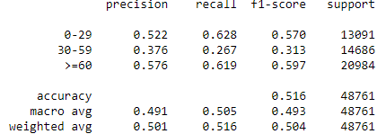
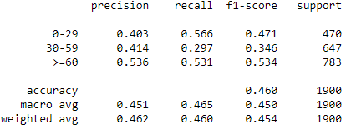
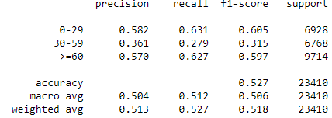
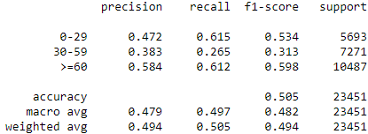
Tweaking: HDBSCAN with LogReg (Survival months, 3 ranges)
Base
Cluster 0
Cluster 1
Cluster 2
Cluster 1 confusion matrix
Notes:
Same issue before, recall of class 2, actual class 2 getting predicted as 0 or 1 (FN), resulting in a lot of FP for other classes (decreasing precision)
Looking at past papers, range of 0-6, 6-24 is the easiest range to predict, plus 5 years is easier as well because many datapoints

Slide 22
Conclusion and Future Considerations
To improve model:
Improve on feature selection method, find a filtered dataset that improves model
Once dataset is filtered, use dummy variables for categorical variables, instead of ordinal labels, especially for nominal variables without order (e.g., Race)
Other methods to deal with binned data (e.g., Age)
Create a new feature using mean or mode of each age bucket which would add additional weight for bins
Create two new features, one for lower bound of age and another for upper bound, obtaining more information about numerical bins
Use under sampling of majority class, SMOTE/oversampling of the minority class or cost sensitive sampling method to even out target class
Other research papers:
Used more complex models like neural networks, ensemble models
Applied meta-classifiers: adaptive boosting, stacking
Regressed on subsets of data already separated by survival ranges
Notes:
Numerical bins are treated same as multiple levels of non-numeric feature, but nominal features have no orders and are meaningless, doesn’t provide additional information, at worst: misleading, weight of bins not taken into account
Try: Survival 5 years, not survived
Why not PCA
PCA is desinged for continuous variables. It tries to minimize variance (=squared deviations). The concept of squared deviations breaks down when you have binary variables.

Slide 23
Thank you for your time and attention! Questions?

